Slide 1
BIRCH ALGORITHM
CLUSTERING ALORITHMS

Slide 2
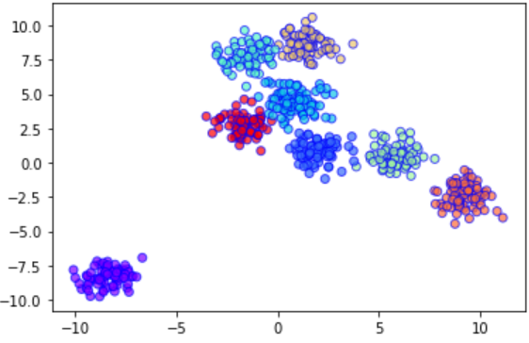
What is BIRCH?
Definition: A clustering algorithm designed for large datasets that incrementally and dynamically clusters incoming data points.
Key Features:
Efficient with large datasets.
Builds a tree structure (CF tree) to represent clusters.
Key Concepts of BIRCH
CF (Cluster Feature) Tree: A hierarchical structure that summarizes clusters using their statistics (e.g., centroid, number of points).
Clustering Phase: Constructs the CF tree during the insertion of data points.
Dynamic Clustering: Can adjust to new data and refine clusters without needing to reprocess the entire dataset.

Slide 3
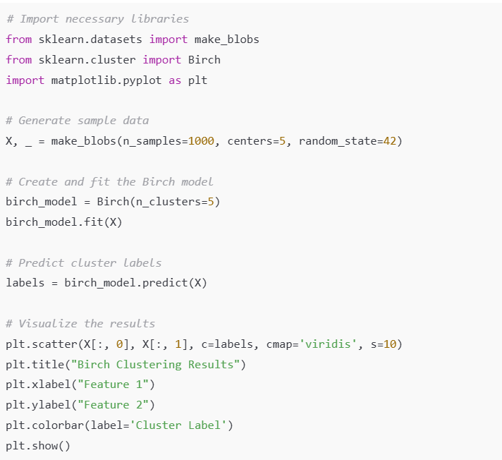
BIRCH in scikit-learn
Examples:

